Slide 1
L11 – Ethics
FIT2101: Software Engineering Process and Management
S2 2020

Slide 2
In this lecture…
Ethics
definition
ethics and morality
the IEEE/ACM Code of Ethics for software engineers
Legal issues
intellectual property
patents, trademarks, and copyright
liability

Slide 3
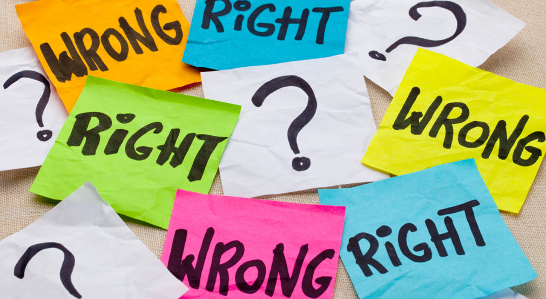
Ethics for software engineers
As software professionals, we need to make sure that our conduct and the software we produce are not only correct but ethically sound.

Slide 4
Morality
Most of us probably know what morality is, but let’s define our terms to be absolutely sure we understand them
Dictionary definition:
Usually, moral principles refer to a society’s rules of conduct
what should people do in various different situations?
which behaviours are right and which are wrong?
Principles concerning the distinction between right and wrong or good and bad behaviour.
‘the matter boiled down to simple morality: innocent prisoners ought to be freed’
(Oxford English Dictionary)
Notes:
It’s always important to make sure you’ve agreed on your terms before you embark on any philosophical discussion. Otherwise, you will end up arguing around and around in circles over minor points of semantics.

Slide 5
Ethics
The word ethics has two possible meanings:
the moral principles that govern a person’s behaviour, or the conducting of an activity
the branch of philosophy dealing with moral principles
We are concerned with the first of these definitions
specifically, we’re concerned with the principles that govern how you should behave as a software engineer (or other software professional)

Slide 6
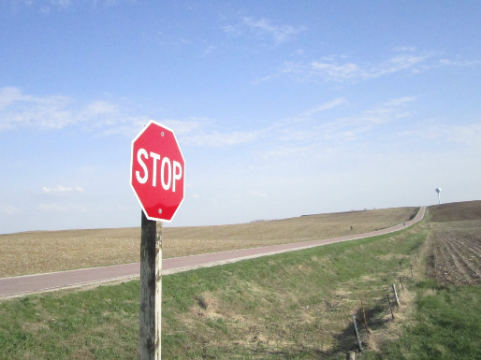
Morality, ethics, and the law
Don’t assume that ethical behaviour is the same as moral or legal behaviour
There are things that are legal but immoral
lying is legal (unless you’re under oath)
lying to your spouse is usually immoral but not unethical
lying to your clients is immoral and unethical
There may be things you can do that are illegal but not unethical or immoral
it’s illegal in Australia to pass a stop sign without stopping, even if it’s safe
for most people, it’s morally okay
it’s only unethical if you’re a professional driver
Notes:
Lying under oath is illegal. Lying when not under oath isn’t illegal, but might be immoral, depending on what you’re lying about and who you’re lying to.
Lying to your spouse may be morally okay in some contexts. It depends on what you’re lying about, and why.
Most people would consider it immoral to run a stop sign if doing so would put yourself or others at risk.

Slide 7
The Software Engineering Code of Ethics
The Association for Computing Machinery and the IEEE Computer Society jointly developed a Software Engineering Code of Ethics
recommended as a standard for professional practice
also recommended as a standard for teaching software engineering
Available in “short version” and “full version”
you’re expected to comply with all of it though
Not legally enforceable
but if you breach it, you’re probably doing something unethical
Contains eight principles, listed in decreasing order of importance

Slide 8
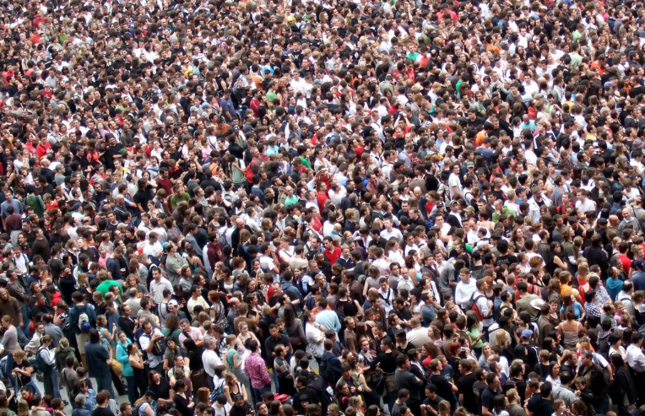
The public
“Software engineers shall act consistently with the public interest.”
Notes:
Software engineers shall act consistently with the public interest. In particular, software engineers shall, as appropriate:
1.01. Accept full responsibility for their own work.
1.02. Moderate the interests of the software engineer, the employer, the client and the users with the public good.
1.03. Approve software only if they have a well-founded belief that it is safe, meets specifications, passes appropriate tests, and does not diminish quality of life, diminish privacy or harm the environment. The ultimate effect of the work should be to the public good.
1.04. Disclose to appropriate persons or authorities any actual or potential danger to the user, the public, or the environment, that they reasonably believe to be associated with software or related documents.
1.05. Cooperate in efforts to address matters of grave public concern caused by software, its installation, maintenance, support or documentation.
1.06. Be fair and avoid deception in all statements, particularly public ones, concerning software or related documents, methods and tools.
1.07. Consider issues of physical disabilities, allocation of resources, economic disadvantage and other factors that can diminish access to the benefits of software.
1.08. Be encouraged to volunteer professional skills to good causes and contribute to public education concerning the discipline.

Slide 9

Client and employer
“Software engineers shall act in a manner that is in the best interests of their client and employer consistent with the public interest.”
Notes:
Software engineers shall act in a manner that is in the best interests of their client and employer, consistent with the public interest. In particular, software engineers shall, as appropriate:
2.01. Provide service in their areas of competence, being honest and forthright about any limitations of their experience and education.
2.02. Not knowingly use software that is obtained or retained either illegally or unethically.
2.03. Use the property of a client or employer only in ways properly authorized, and with the client's or employer's knowledge and consent.
2.04. Ensure that any document upon which they rely has been approved, when required, by someone authorized to approve it.
2.05. Keep private any confidential information gained in their professional work, where such confidentiality is consistent with the public interest and consistent with the law.
2.06. Identify, document, collect evidence and report to the client or the employer promptly if, in their opinion, a project is likely to fail, to prove too expensive, to violate intellectual property law, or otherwise to be problematic.
2.07. Identify, document, and report significant issues of social concern, of which they are aware, in software or related documents, to the employer or the client.
2.08. Accept no outside work detrimental to the work they perform for their primary employer.
2.09. Promote no interest adverse to their employer or client, unless a higher ethical concern is being compromised; in that case, inform the employer or another appropriate authority of the ethical concern.

Slide 10
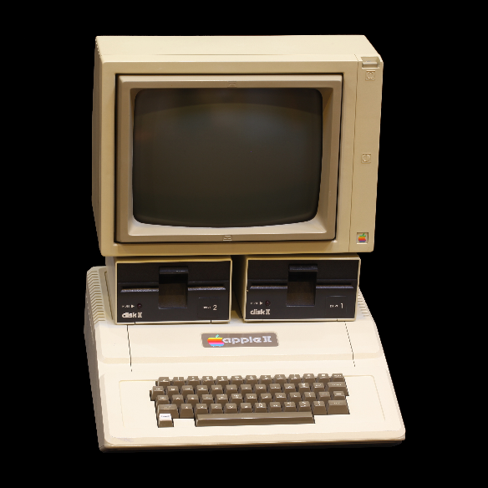
The product
“Software engineers shall ensure that their products and related modifications meet the highest professional standards possible.”
Notes:
Software engineers shall ensure that their products and related modifications meet the highest professional standards possible. In particular, software engineers shall, as appropriate:
3.01. Strive for high quality, acceptable cost and a reasonable schedule, ensuring significant tradeoffs are clear to and accepted by the employer and the client, and are available for consideration by the user and the public.
3.02. Ensure proper and achievable goals and objectives for any project on which they work or propose.
3.03. Identify, define and address ethical, economic, cultural, legal and environmental issues related to work projects.
3.04. Ensure that they are qualified for any project on which they work or propose to work by an appropriate combination of education and training, and experience.
3.05. Ensure an appropriate method is used for any project on which they work or propose to work.
3.06. Work to follow professional standards, when available, that are most appropriate for the task at hand, departing from these only when ethically or technically justified.
3.07. Strive to fully understand the specifications for software on which they work.
3.08. Ensure that specifications for software on which they work have been well documented, satisfy the users’ requirements and have the appropriate approvals.
3.09. Ensure realistic quantitative estimates of cost, scheduling, personnel, quality and outcomes on any project on which they work or propose to work and provide an uncertainty assessment of these estimates.
3.10. Ensure adequate testing, debugging, and review of software and related documents on which they work.
3.11. Ensure adequate documentation, including significant problems discovered and solutions adopted, for any project on which they work.
3.12. Work to develop software and related documents that respect the privacy of those who will be affected by that software.
3.13. Be careful to use only accurate data derived by ethical and lawful means, and use it only in ways properly authorized.
3.14. Maintain the integrity of data, being sensitive to outdated or flawed occurrences.
3.15 Treat all forms of software maintenance with the same professionalism as new development.

Slide 11

Judgment
“Software engineers shall maintain integrity and independence in their professional judgment.”
Notes:
Software engineers shall maintain integrity and independence in their professional judgment. In particular, software engineers shall, as appropriate:
4.01. Temper all technical judgments by the need to support and maintain human values.
4.02 Only endorse documents either prepared under their supervision or within their areas of competence and with which they are in agreement.
4.03. Maintain professional objectivity with respect to any software or related documents they are asked to evaluate.
4.04. Not engage in deceptive financial practices such as bribery, double billing, or other improper financial practices.
4.05. Disclose to all concerned parties those conflicts of interest that cannot reasonably be avoided or escaped.
4.06. Refuse to participate, as members or advisors, in a private, governmental or professional body concerned with software related issues, in which they, their employers or their clients have undisclosed potential conflicts of interest.

Slide 12
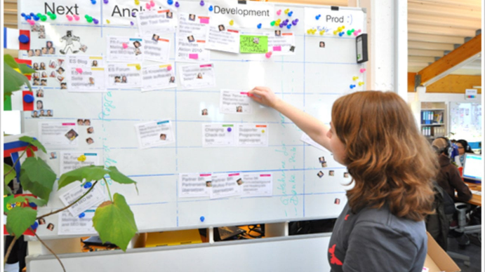
Management
“Software engineering managers and leaders shall subscribe to and promote an ethical approach to the management of software development and maintenance.”
Notes:
Software engineering managers and leaders shall subscribe to and promote an ethical approach to the management of software development and maintenance . In particular, those managing or leading software engineers shall, as appropriate:
5.01 Ensure good management for any project on which they work, including effective procedures for promotion of quality and reduction of risk.
5.02. Ensure that software engineers are informed of standards before being held to them.
5.03. Ensure that software engineers know the employer's policies and procedures for protecting passwords, files and information that is confidential to the employer or confidential to others.
5.04. Assign work only after taking into account appropriate contributions of education and experience tempered with a desire to further that education and experience.
5.05. Ensure realistic quantitative estimates of cost, scheduling, personnel, quality and outcomes on any project on which they work or propose to work, and provide an uncertainty assessment of these estimates.
5.06. Attract potential software engineers only by full and accurate description of the conditions of employment.
5.07. Offer fair and just remuneration.
5.08. Not unjustly prevent someone from taking a position for which that person is suitably qualified.
5.09. Ensure that there is a fair agreement concerning ownership of any software, processes, research, writing, or other intellectual property to which a software engineer has contributed.
5.10. Provide for due process in hearing charges of violation of an employer's policy or of this Code.
5.11. Not ask a software engineer to do anything inconsistent with this Code.
5.12. Not punish anyone for expressing ethical concerns about a project.

Slide 13
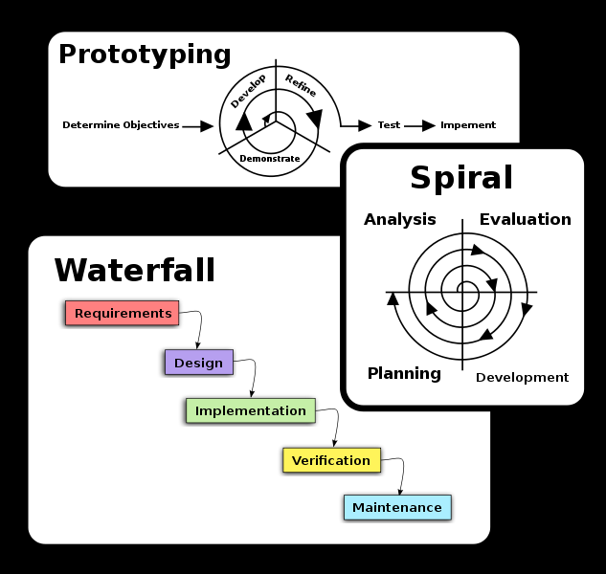
The profession
“Software engineers shall advance the integrity and reputation of the profession consistent with the public interest.”
Notes:
Software engineers shall advance the integrity and reputation of the profession consistent with the public interest. In particular, software engineers shall, as appropriate:
6.01. Help develop an organizational environment favorable to acting ethically.
6.02. Promote public knowledge of software engineering.
6.03. Extend software engineering knowledge by appropriate participation in professional organizations, meetings and publications.
6.04. Support, as members of a profession, other software engineers striving to follow this Code.
6.05. Not promote their own interest at the expense of the profession, client or employer.
6.06. Obey all laws governing their work, unless, in exceptional circumstances, such compliance is inconsistent with the public interest.
6.07. Be accurate in stating the characteristics of software on which they work, avoiding not only false claims but also claims that might reasonably be supposed to be speculative, vacuous, deceptive, misleading, or doubtful.
6.08. Take responsibility for detecting, correcting, and reporting errors in software and associated documents on which they work.
6.09. Ensure that clients, employers, and supervisors know of the software engineer's commitment to this Code of ethics, and the subsequent ramifications of such commitment.
6.10. Avoid associations with businesses and organizations which are in conflict with this code.
6.11. Recognize that violations of this Code are inconsistent with being a professional software engineer.
6.12. Express concerns to the people involved when significant violations of this Code are detected unless this is impossible, counter-productive, or dangerous.
6.13. Report significant violations of this Code to appropriate authorities when it is clear that consultation with people involved in these significant violations is impossible, counter-productive or dangerous.

Slide 14

Colleagues
“Software engineers shall be fair to and supportive of their colleagues.”
Notes:
Software engineers shall be fair to and supportive of their colleagues. In particular, software engineers shall, as appropriate:
7.01. Encourage colleagues to adhere to this Code.
7.02. Assist colleagues in professional development.
7.03. Credit fully the work of others and refrain from taking undue credit.
7.04. Review the work of others in an objective, candid, and properly-documented way.
7.05. Give a fair hearing to the opinions, concerns, or complaints of a colleague.
7.06. Assist colleagues in being fully aware of current standard work practices including policies and procedures for protecting passwords, files and other confidential information, and security measures in general.
7.07. Not unfairly intervene in the career of any colleague; however, concern for the employer, the client or public interest may compel software engineers, in good faith, to question the competence of a colleague.
7.08. In situations outside of their own areas of competence, call upon the opinions of other professionals who have competence in that area.

Slide 15

Yourself
“Software engineers shall participate in lifelong learning regarding the practice of their profession and shall promote an ethical approach to the practice of the profession.”
Notes:
Software engineers shall participate in lifelong learning regarding the practice of their profession and shall promote an ethical approach to the practice of the profession. In particular, software engineers shall continually endeavor to:
8.01. Further their knowledge of developments in the analysis, specification, design, development, maintenance and testing of software and related documents, together with the management of the development process.
8.02. Improve their ability to create safe, reliable, and useful quality software at reasonable cost and within a reasonable time.
8.03. Improve their ability to produce accurate, informative, and well-written documentation.
8.04. Improve their understanding of the software and related documents on which they work and of the environment in which they will be used.
8.05. Improve their knowledge of relevant standards and the law governing the software and related documents on which they work.
8.06 Improve their knowledge of this Code, its interpretation, and its application to their work.
8.07 Not give unfair treatment to anyone because of any irrelevant prejudices.
8.08. Not influence others to undertake any action that involves a breach of this Code.
8.09. Recognize that personal violations of this Code are inconsistent with being a professional software engineer.

Slide 16
Ethics in your software projects
So far, your programming probably hasn’t had much of an ethical dimension
the “public good” isn’t a consideration if you and your teachers are the only people who ever run your code…
But this will soon change
FIT3047/FIT3048: Industry Experience project (industry client)
FIT3170 Software Engineering practice
FIT4002 Software Engineering industry experience studio project (industry client)
Industry Based Learning
professional practice
Better have some kind of strategy worked out for dealing with potential ethical issues

Slide 17
Ethics audits
Idea: during the inception phase of your project, consider conducting an ethics audit
is this software in the public interest?
is our software likely to put anybody at risk of harm?
do we have a plan to protect our users from harm?
do we have a plan to protect the people and organizations whose identifiable data we store?
Revisit your ethics audit periodically during the project
Can make this process part of your regular risk management activities

Slide 18
Legal issues
Your projects may have legal ramifications
Law concerning software, networking, online behaviour etc. is a very big subject
we can’t cover much of it here
We will just go over a few of the relevant concepts
intellectual property
software licensing
liability
If you think your project may be put at risk due to legal issues, you should consult a lawyer

Slide 19

Property and intellectual property
We all know what property is
things that somebody can own
property can be bought and sold
owners have the right to determine who can use their property, and how
The right to property is enshrined in Article 17 of the UN’s Universal Declaration of Human Rights
Intellectual property law extends these concepts to creations of the mind: ideas, inventions, designs, algorithms, artworks, etc.
Everyone has the right to own property alone as well as in association with others.
No one shall be arbitrarily deprived of his property.
Notes:
Folk at Sunway: Article 13 of the Malaysian constitution also recognizes an individual’s right to own property.

Slide 20
Copyright
Copyright covers original works rather than the ideas behind them
this includes program source code
doesn’t necessarily include algorithms
Literally means the right to make copies
but also covers the right to “perform” (i.e. run), distribute, or create derivative works
Automatically granted to the creator of the work at the time of creation
if you create software while at work, it belongs to your company
if you are a contractor, your contract will say who owns the IP you’ve created

Slide 21
Copyright and reverse-engineering
Reverse-engineering a program means looking at how it behaves given different inputs
It is not a copyright offence under Australian copyright law to clone a program by reverse-engineering provided you don’t look at the code
if you look at the code, you’re creating a derivative work
porting to a new language or platform is also creating a derivative work
Just because it’s not a copyright offence doesn’t mean it’s going to be okay
might still be a breach of your licensing conditions
most commercial software licences prohibit reverse-engineering
if in doubt, don’t do it

Slide 22
Software patents
Patents apply to inventions, and give the owner of the patent exclusive rights over them for a limited time
idea is to ensure that inventors get a chance to profit from their inventions
this promotes innovation
Doesn’t necessarily mean you can’t use the invention
usually means you’ll need to pay a fee to the patent owner (i.e. purchase a licence)
licences can be expensive
Software isn’t patentable everywhere but is patentable in Australia
if operating in another country, check with a qualified legal professional
Unlike copyright, patents aren’t automatic – you have to apply for one
this costs a lot, and it might not be granted
so not all software is patented

Slide 23
Trade secrets, confidentiality, and NDAs
Some companies have critical business secrets
e.g. formula for Coca-Cola, recipe for KFC
Not the same as copyrights or patents!
copyrights and patents expire with time
copyrights and patents apply to everyone, confidentiality agreements only apply to the signatories
Typically protected by making people (e.g. employees) agree to keep the secret before disclosing
in the US: nondisclosure agreement
in Australia: deed of confidentiality
anywhere: clause in your contract that says you’re not allowed to disclose company secrets
Basic idea: before you are given the secret information, you must agree not to disclose it to a third party
if you do, the company can sue you

Slide 24
Software licensing
When you’re granted the ability to use a piece of software, it’s typically by accepting a software licence
The owner of the intellectual property is granting you permission to use it provided certain conditions are met, e.g.:
disallowing reverse-engineering
restrictions on number of users
restrictions on the number of computers you can install on, etc.

Slide 25
Open source software
Open source software is released under an open source licence
that is, a licence that allows for the code to be used, modified, and shared
Don’t assume you can do what you like with open source software!
it is still covered by copyright
breaking an open source licence means you can be sued by the rights holder
Many open source licences exist
some are permissive, e.g. MIT: “do whatever you want but keep this copyright notice in”
some are restrictive, e.g. GPL
If you want to use somebody else’s code for work, or even for educational purposes, check the licensing terms to make sure this use is allowed

Slide 26
Public domain software
Public domain software isn’t owned by anyone
i.e. not covered by copyright, patent, etc.
Copyright is automatic under international law (the Berne Convention)
software is not public domain by default
but authors are allowed to relinquish their rights in most jurisdictions
Public domain software was very common before the 1990s
less so now, since there are more other options available
These days, public domain releases are usually released under the CC0 licence (Creative Commons Zero)
this is a licence, but it waives as many rights as possible

Slide 27
Legal liability
Under Australian law, you can be sued for negligence if
you have a duty of care (i.e. a moral responsibility to look after something)
you breach that duty
the person suing you suffers loss or damage as a result
No legal precedent for software engineers having a duty of care to their clients or users… yet
but this doesn’t mean that one will never arise!
Clients are also covered by Australian Consumer Law (2010)
this law covers “goods and services”
“computer software” is explicitly declared to be “goods”, but is not unambiguously defined…
ACL says you’re liable if your goods are not of acceptable quality
doesn’t mean zero defects
does imply reasonable efforts to ensure quality
Notes:
Schools have a duty of care to their students, and medical professionals to their patients. It’s not impossible that some case will someday establish that a software developer has a duty of care to their clients and/or end users, and as software engineering becomes less of a black art and more of a profession, the probability that this will happen continues to grow.

Slide 28
A final word about legal issues
If you are unsure about whether a particular course of action is legal or not, or whether you might be open to a lawsuit,
GET LEGAL ADVICE
from a qualified legal practitioner.

Slide 29
Summary
Ethics in software engineering
Legal aspects of software engineering

Slide 30
Next lecture
The limits of Agile

